Slide 1







Stack Overflow Survey 2023
Shahid
02 July 2023

Slide 2



OUTLINE
Executive Summary
Introduction
Methodology
Results
Visualization – Charts
Dashboard
Discussion
Findings & Implications
Conclusion
Appendix

Slide 3

EXECUTIVE SUMMARY
Familiarizing, cleaning and wrangling collected data
Analyzing Data
Exploring Trends
Relationships
Presenting Results with Graphs and Charts
Presenting Findings and Implications
Discussion of the finding, results and trends
Conclusion of the projects

Slide 4

INTRODUCTION
Stack Overflow’s Annual Summary
One of the biggest survey in tech world
90,000 developers participated in survey about how they learn and level up, which tools they're using, and which ones they want.
What are the current trends
Where is the future heading towards

Slide 5

METHODOLOGY
Data Collection through different tools
Data Cleaning
Missing data handling
Outliers handling
Data Analysis
Data Visualization
Data distribution
Relations
Results
Trends

Slide 6
RESULTS
This Section Presents Results of the Projects

Slide 7
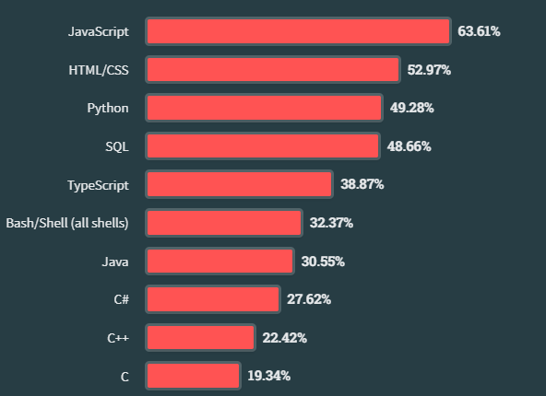
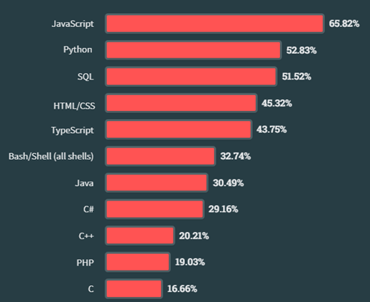
PROGRAMMING LANGUAGE TRENDS
2023
2024

Slide 8
PROGRAMMING LANGUAGE TRENDS - FINDINGS & IMPLICATIONS
Findings
JavaScript Stays on top
New coders prefer Python
JavaScript, Python, HTML/CSS remains in top 3
Implications
Interest towards General purpose languages
Python is growing
Ruby, VB etc. are shrinking

Slide 9
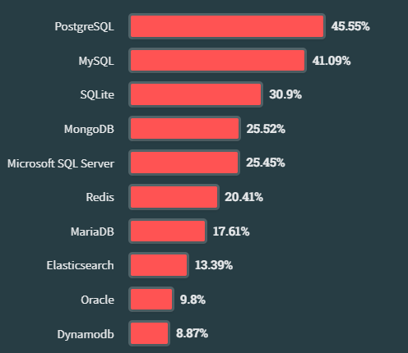
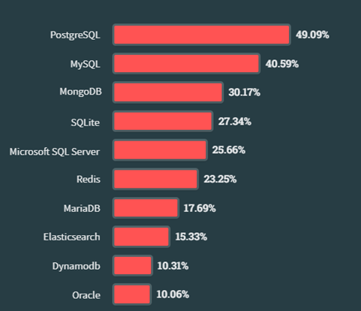
DATABASE TRENDS
2023
2024

Slide 10
DATABASE TRENDS - FINDINGS & IMPLICATIONS
Findings
PostgreSQL in on top
MySQL & SQLite are used widely
Oracle and MS SQL server are overpowered by MangoDB
Implications
MySQL is still the DB of choice for newbies
PostgreSQL is popular among professional
Oracle & SQL server etc. are losing the market

Slide 11

DASHBOARD
This Section Presents Dashboard - Charts

Slide 12
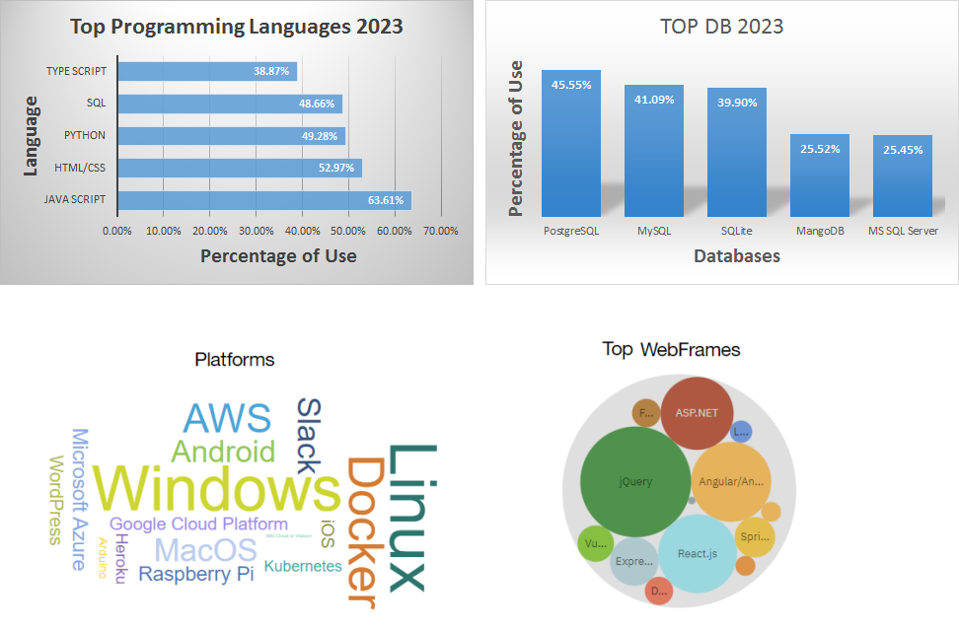
DASHBOARD TAB 1 – 2023

Slide 13
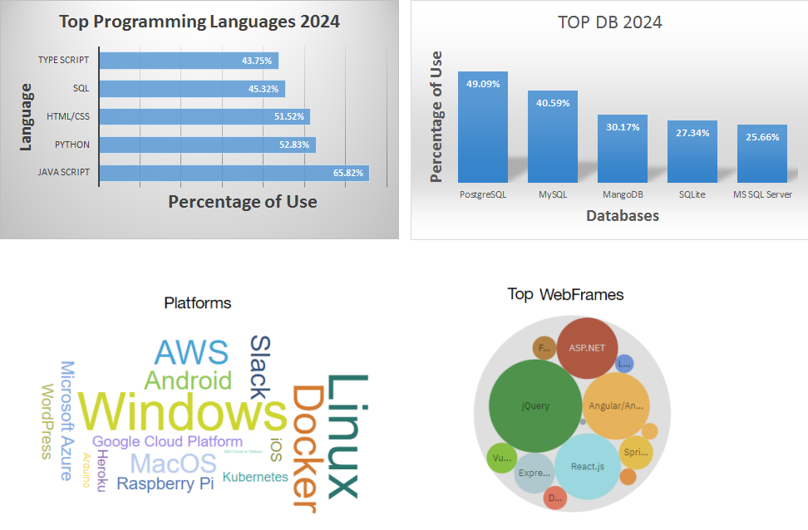
DASHBOARD TAB 2 - 2024

Slide 14
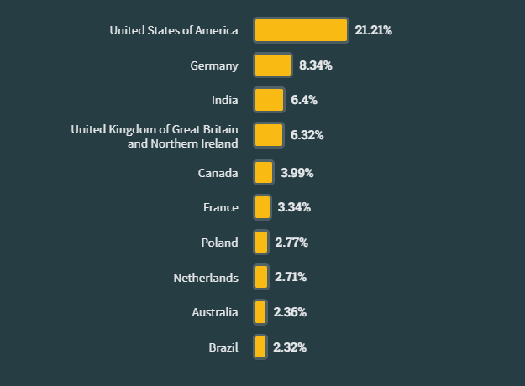
Demographics
Top 10 Countries

Slide 15
DISCUSSION
The data seems very authentic as stack overflow is one of the top place for programmers and developers to go to. The trends and data correlates with technology and jobs.

Slide 16
OVERALL FINDINGS & IMPLICATIONS
Findings
Java Scripts is popular and Python is getting popular with rise of AI
Young men from developing countries are mostly the interested ones.
Complex languages and DBs are replacing by user friendly ones.
Implications
Skills are more promising in getting jobs than degrees
AI powered technology is getting popular
Women rate in technological fields are increasing

Slide 17

CONCLUSION
Globalization making it possible to work from any where, with skill set despite background education
Programming is becoming more AI oriented
Young generation uplifting economies

Slide 18

APPENDIX
Include any relevant additional charts, or tables that you may have created during the analysis phase.

Slide 19
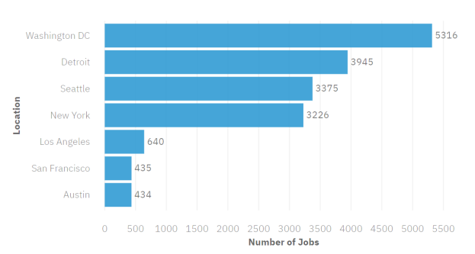
JOB POSTINGS

Slide 20
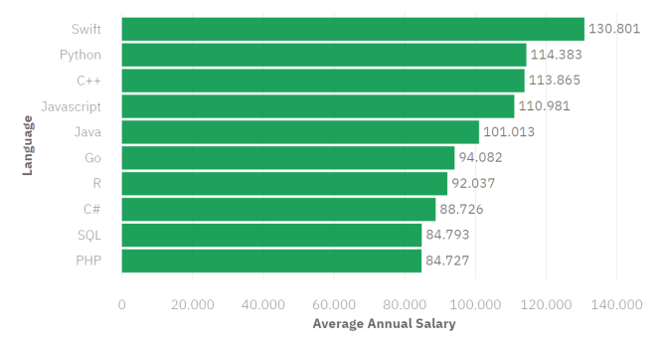
POPULAR LANGUAGES

